Slide 1


Automating Your Salt Tests
Ryan Currah github@ryancurrah twitter@rcurrah

Slide 2

MY EXPERIENCE
Was lead Salt engineer for large Canadian bank
Develop formulas
Salt master architecture
Salt git development strategy
Salt testing and testing automation

Slide 3
TALK GOAL
Help newer Salt users start off on the right foot

Slide 4

DON’T FORGET TO AUTOMATE TESTING
If you don’t automate testing it will become a bottleneck If you do automate testing you will catch issues early and feel confident when you release

Slide 5
TESTING AS CODE
Requirements
State testing defined as code
Jobs defined as code
Pipeline capabilities
Fast testing feedback
Tools were on premise

Slide 6
TESTING TOOLS SELECTED
Code analysis: shellcheck (bash), flake8 (python)
State testing: ServerSpec
Container: Docker
Test orchestration: Jenkins Pipeline (Formerly Workflow)
Versioning: Git tag + bumpversion

Slide 7
CODE ANALYSIS ON FORMULAS
Not uncommon to see scripts in formulas
Code analysis enables
Good coding styles
Consistency
Express how we want code to be written
No jinja templated scripts (Use cmd.script w/ input arguments instead)

Slide 8
TEST STATE
Two different views of state
For example in the issue github.com/saltstack/salt/issues/24647
file.copy state with force=True did not work
Reported no changes when the file should have changed
ServerSpec tests caught this issue
Audit formula changes
Formula changes will be captured by tests

Slide 9
ServerSpec
What can you test?
Process is running
Service is running
Service is enabled on boot
Port is open
Firewall rule exists
Package is installed
User and group exists
File exists
File user and group ownership
File hashes
The list goes on see… http://serverspec.org/resource_types.html
Reuseable spec files known a shared files
http://serverspec.org/advanced_tips.html
https://github.com/rubyisbeautiful/serverspec_examples

Slide 10
JOBS AS CODE
Jenkins Pipeline enables jobs as code and a deilvery pipeline (without the spaghetti jobs)
Jenkinsfile (Groovy script) placed in the Salt formula repo
Pipeline stages (Build, QA, Production)
Pipeline visualization and metrics
Average build time, current build time, stage views, failed steps

Slide 11
JENKINS PLUGINS USED
Pipeline
Pipeline: Multibranch
Pipeline Remote Loader Plugin
Git Plugin
SSH Agent Plugin
AnsiColor Plugin

Slide 12
JENKINS SERVER SETUP
Docker installed
Docker allow Jenkins user to run it
Testing container with systemd, salt-minion, ruby, shellcheck and flake8 installed
Bumpversion installed
Git SSH credential setup for pushing tags

Slide 13
RUNNING SERVICES IN CONTAINERS
Install systemd in the testing container
Remove systemd links in /etc/systemd
Mount cgroups to container (ro)
Privileged container or –v /tmp:/run
Run command /usr/sbin/init
Source: https://rhatdan.wordpress.com/2014/04/30/running-systemd-within-a-docker-container/

Slide 14
FORMULA REPOSITORIES
Create a repository for each formula
Repository has a tests folder
Release updates independent of other states
Use git backend for formulas

Slide 15
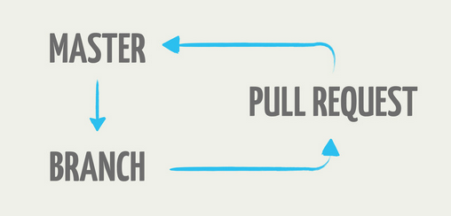
BRANCHING STRATEGY
GITHUB FLOW

Slide 16
DEVELOPING LOCALLY
Provide salt formula developers a local development environment
Create a vagrant box or docker image (RHEL developer licenses are free now)
Provide an example formula with tests
Document how to get started
Jenkins feature testing

Slide 17
GOOD PULL REQUESTS
Salt best practices
Less Jinja the better
No Jinja whitespace control characters in sls files
defaults.yaml
Pillars are for overiding defaults
Predictable and sane state id’s
https://docs.saltstack.com/en/latest/topics/best_practices.html
https://docs.saltstack.com/en/latest/topics/development/conventions/
Require tests pass
Review code together
Potential bugs
Readability
Test coverage (ServerSpec tests)
Compliment / reinforce good practices
http://kevinlondon.com/2015/05/05/code-review-best-practices.html

Slide 18
RELASING NEW SALT FORUMLAS
Use semantic versioning
Example v0.2.0
semver.org
Tag releases
Tag new version v0.3.0
Re-tag “latest”
Bumpversion will automatically bump the forumula version
Rollback “latest” to a previous version if things break
Salt-masters use the gitfs backend docs.saltstack.com/en/latest/topics/tutorials/gitfs.html#per-remote-configuration-parameters

Slide 19
SALTSTACK GIT BACKENDS Pygit and Gitpython
Pygit2
Supports authentication
Cloning process tends to hang
Gitpython
Easy to install
No authentication supported

Slide 20
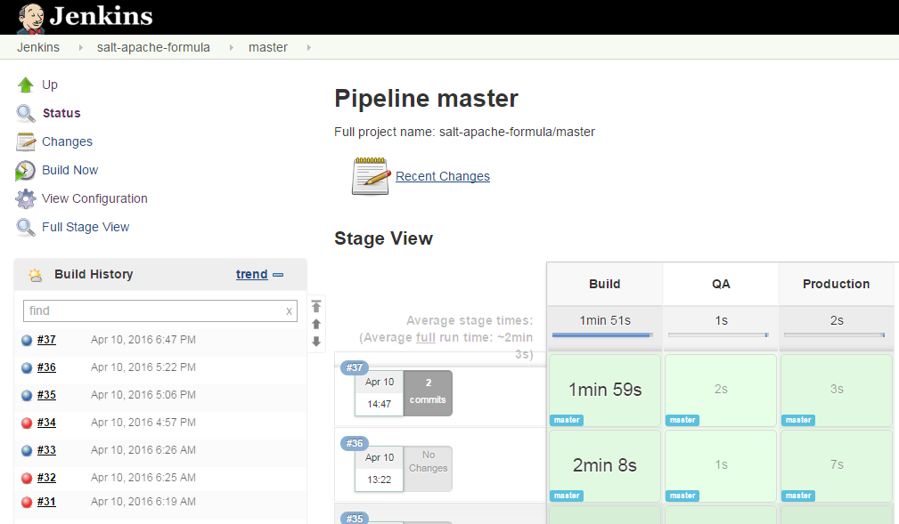
DEMO
Jenkins Pipeline
Pipeline script
Multibanch pipeline jobs
Testing feature branches
Testing master branches
ServerSpec output
Automatic promotion

Slide 21
STATE EVENTS
What is a state event?
Result of a state execution in a structured format that a can be parsed
Why state events?
Analytics on state execution results
Alert operations on failed states
Easily compile issue reports for engineering
More details: http://www.currah.ca/tech/2015/12/09/salt-state-events-splunk.html
New splunk returner: https://github.com/saltstack/salt/blob/develop/salt/returners/splunk.py

Slide 22
EVENT RETURNER
Event returners only run on the master
Salt has a list of event returners or build your own
Create your own returner, place in _returners directory
Returner state events basically state.sls and state.highstate
Add minion id and jid to state return data for correlating state events to a specific host or action
More details: http://www.currah.ca/tech/2015/12/09/salt-state-events-splunk.html
Splunk returner: https://github.com/saltstack/salt/blob/develop/salt/returners/splunk.py
List of Returners: https://docs.saltstack.com/en/latest/ref/returners/

Slide 23
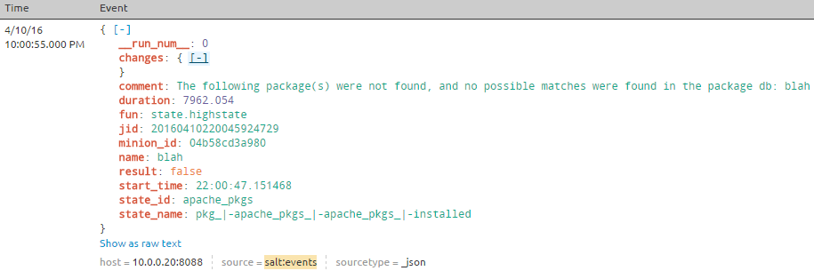
EXAMPLE STATE EVENT
Automatic Field Extraction

Slide 24
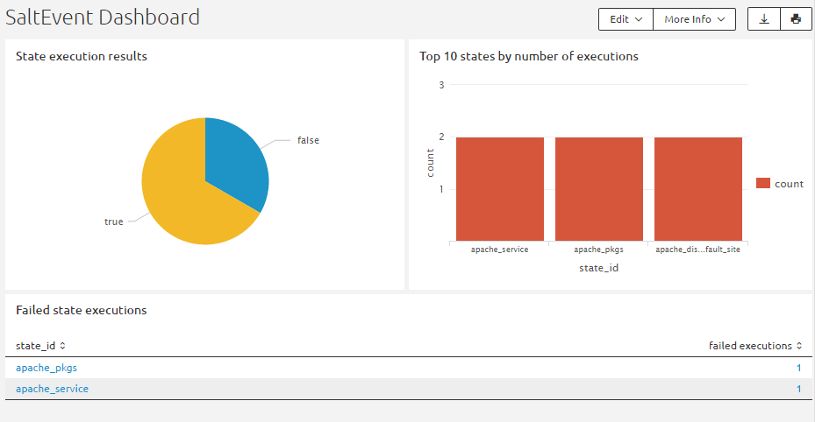
DEMO
SALTSTACK STATE EVENTS
Generating events
Searching events
Event dashboard

Slide 25
CODE
https://github.com/ryancurrah/vagrant-salt-talk
https://github.com/ryancurrah/salt-minion-dockerfile
https://github.com/ryancurrah/salt-pipeline
https://github.com/ryancurrah/salt-apache-formula
https://github.com/ryancurrah/salt-lint-example
https://github.com/ryancurrah/salt-splunk-http-returner

Slide 26
Questions?

Slide 27
Please Provide Feedback
Use the SaltConf16 event app to provide feedback for this presentation.

